Slide 1

Random Word Guess Game

Slide 2
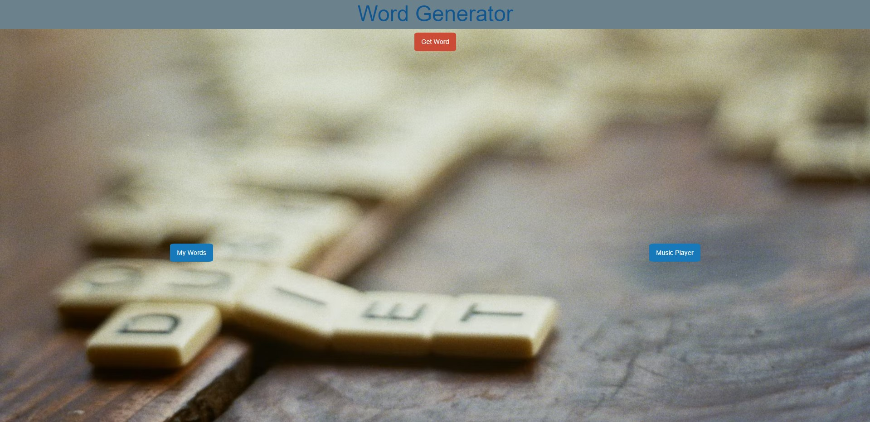

Slide 3
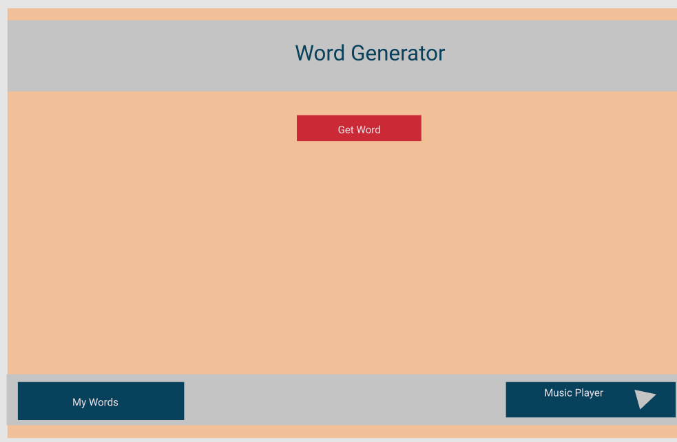

Slide 4
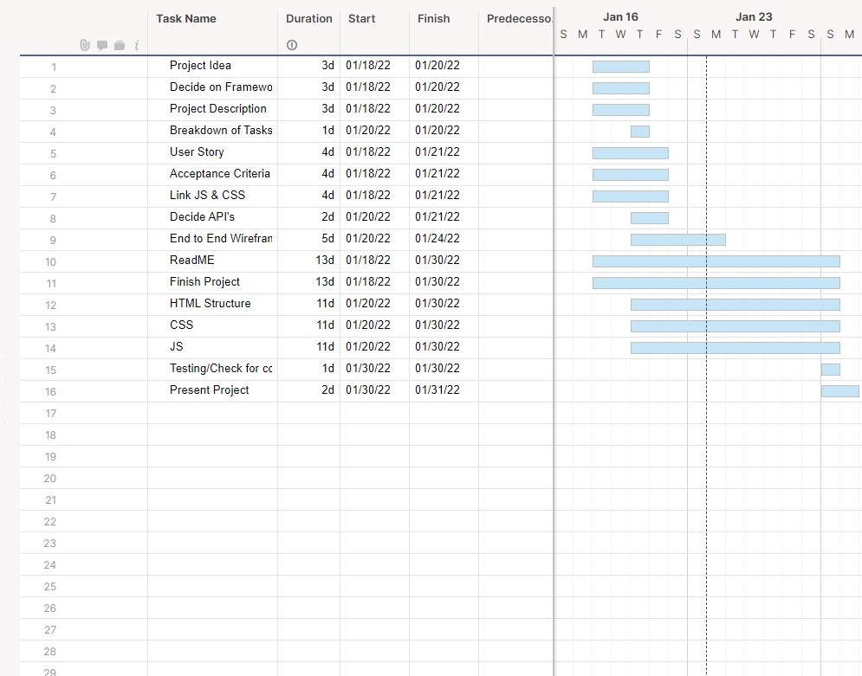

Slide 5


Slide 6


Slide 7
Demo - need to put a gif or something in here, maybe an external link?

Slide 8


Slide 9
Links
https://mattdsena.github.io/GroupProject/
https://github.com/Mattdsena/GroupProject

